Slide 1




Home
About us
Startegy
Contact
CV online
Builder
Group 9
Team Member
Phạm Đăng Quang - ITCSIU21147
Đặng Đình Nguyên - ITITIU20133
Đỗ Tấn Lộc - ITCSIU21199
Phạm Quốc Huy - ITITIU21215
Page 01
Page 01

Slide 2

Home
About us
Startegy
Contact
Table of Content
1. Introduction
2. Development Process
a. Work Breakdown Structure
b. System Workflow
3. Implementation
a. Diagrams
b. Requirement Analysis
4. Demo
5. Conclusion
Page 02

Slide 3

Home
About us
Startegy
Contact
Introduction
Background
The primary objective of the project is to develop a website that makes it simple for users to produce, modify, and update resumes. This website is helpful since businesses prefer to view digital resumes and job seekers want to showcase their accomplishments and abilities in a distinctive and professional way. Second, the project aims to create a functioning, user-friendly website that can be tailored to suit different requirements. A broad spectrum of software engineering skills, such as problem-solving, system design, coding, testing, and result validation, will be required for this project
Page 03

Slide 4
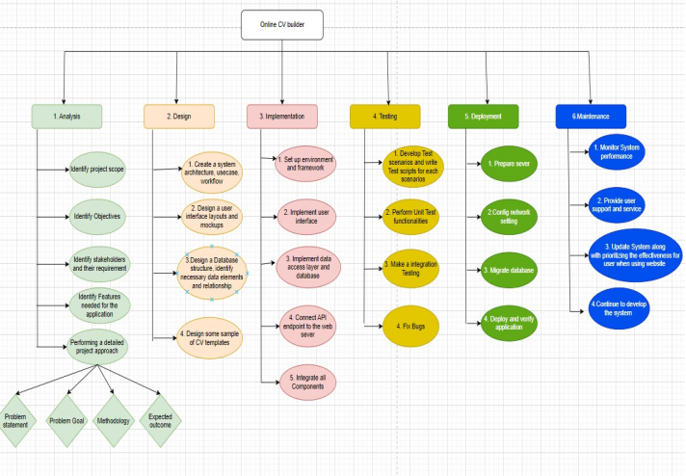
Home
About us
Startegy
Contact
Development
Process
Work Breakdown Structure
Page 04

Slide 5
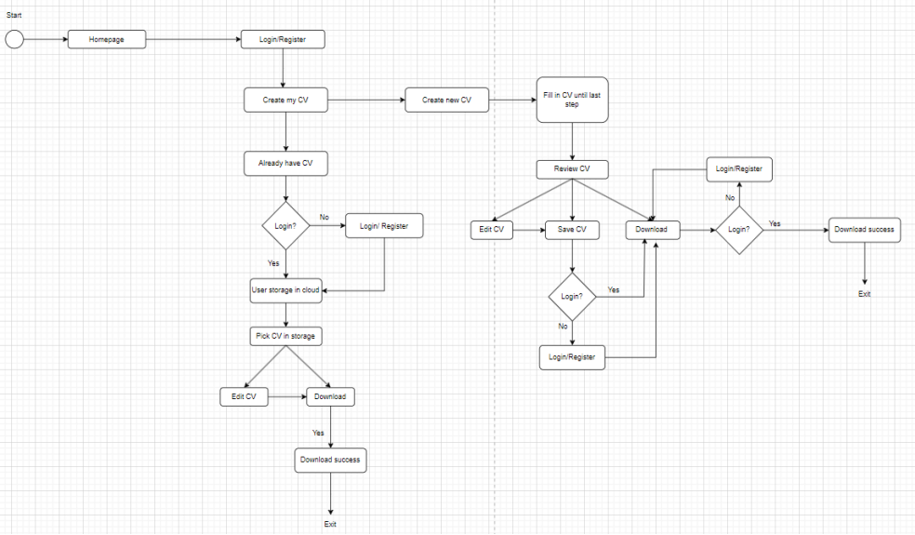
Home
About us
Startegy
Contact
Development
Process
System Workflow
Page 05

Slide 6






Home
About us
Startegy
Contact
Implementation
technology
Page 06

Slide 7
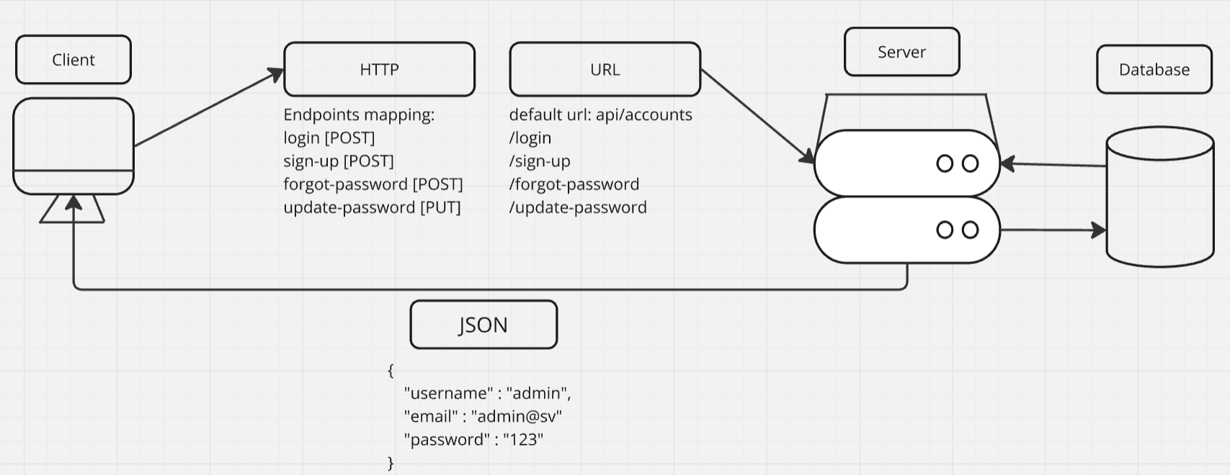
Home
About us
Startegy
Contact
API
Diagram
Page 07

Slide 8
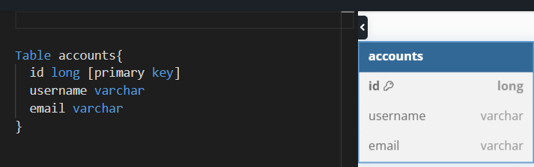
Home
About us
Startegy
Contact
ERD
Diagram
Page 08

Slide 9
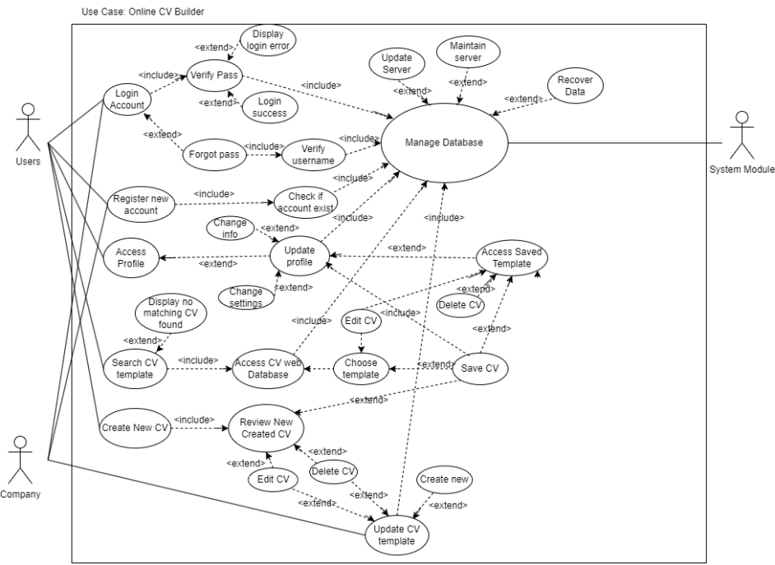
Home
About us
Startegy
Contact
Use Case Diagram
Page 09

Slide 10
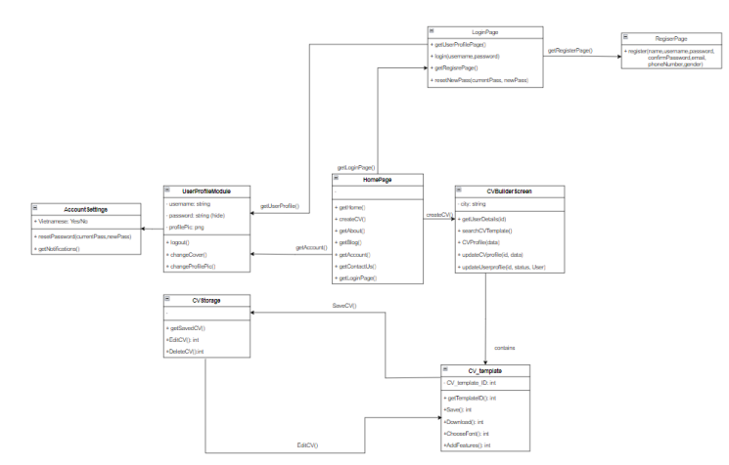
Home
About us
Startegy
Contact
Class Diagram
Page 10

Slide 11




Home
About us
Startegy
Contact
Requirements
Analysis
Functional Requirements
Non-Functional Requirements
·Authenticate user login credentials.
Allow users to input CV information.
Generate a new CV based on user input and a CV Template.
Be able to store new CVs in the Database.
Allow users to input keywords to search/filter criteria.
Retrieve matching CVs from the CV Database based on user input.
Allow users to access the CV template after searching for editing, saving, and downloading.
Allow users to save CVs to their UserStorage.
Allow users to download CVs
Usability Requirements
Performance Requirements
Space Requirements
Dependability Requirements
Security Requirements
Environmental Requirements
Operational Requirements
Development Requirements
Page 11

Slide 12
Home
About us
Startegy
Contact
Demo
Page 12

Slide 13
Home
About us
Startegy
Contact
Conclusion
Summerize
In conclusion, we have created an online CV builder that allows users to create and download customized CVs in PDF format.
Not only we have included templates, sections, fields, fonts, colors, previews, and downloads in the online CV builder website. But also we have incorporated animations into the website to make it look more professional.
We have developed an online CV Builder that enables users to generate and save customized resumes in PDF format. In the Implementation section, we also demonstrated the features and capabilities of our online CV maker.
Page 13

Slide 14
Home
About us
Startegy
Contact
Thank
You.
Thank
You.
Thank
You.
Page 14

